Slide 1
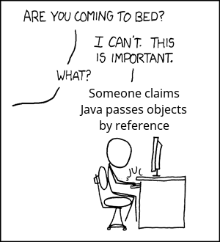
Modular Programming 2
Pass by Value vs Pass by Reference and Return Values

Slide 2
Function Parameters
Function parameters:
Parameter declaration
type identifier [= default-value] [, …]
Local scope to function only
Pass-by-Value
Value is copied from calling statement to parameter
Modifications do not change value of variables in caller
Pass-by-Reference
Address of variable is passed as parameter
Modifications are reflected in caller variables
Use ampersand “&” between type and identifier
Return value – must be of same type as defined return

Slide 3
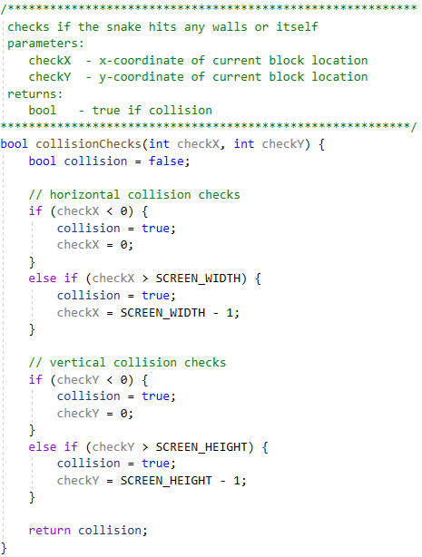
Collision Checks Function
(2)
Define a collision check function between main and render functions
Returns true if collision is detected
Accepts (x, y) coordinates to check
Use different names for (x,y) parameters
Build a function header comment block
Declare a return variable of the return type and initialize it
Add a return statement that returns the variable
Move the collision checking code to the function body
Change local variable names to match parameters and return variable
(1)
(3)
(5)
(4)

Slide 4
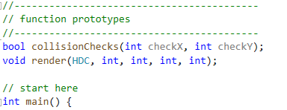
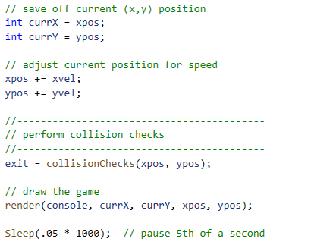
Declare and Call Collision Checks
Add function declaration for collision checks function above main
Add a call to collision checks function inside main
Build and run the program…
…do collision checks still work?
…what isn’t working and why?

Slide 5
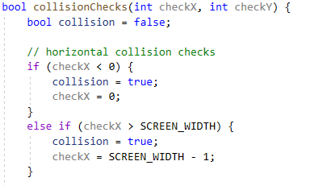
Pass-by-Value
Variables xpos and ypos are copied (pass-by-value) so changes
Changes made to checkX and checkY are lost after function returns

Slide 6

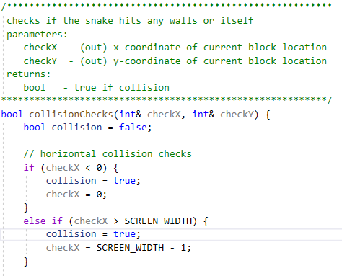

Pass-by-Reference
Change function declaration to pass-by-reference
Change function definition to pass-by-reference
Indicate output parameters in parameter documentation
Ampersand is normally placed on tail end of data-type as it works best when no identifier is provided:

Slide 7
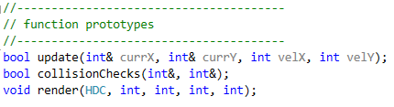
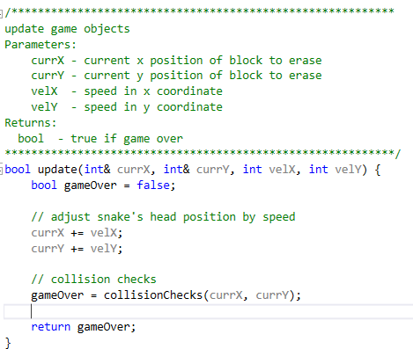
Update Function
(6)
Define an update function between main and collision checks functions
Returns true if game over
Parameters:
Current (x, y) (by-reference)
Velocity (x, y) (by-value)
Build a function header comment block
Declare a return variable of the return type and initialize it
Add a return statement that returns the variable
Move the update code to include call to collision checks function to body
Change local variable names to match parameters and return variable
Add function prototype above main
(2)
(1)
(3)
(5)
(4)

Slide 8
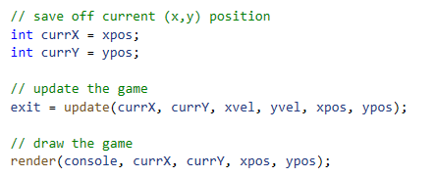
Call Update
Add a call to update in main
We still need to save off current (x, y) coordinates
Snake position (x, y) coordinates may be modified inside call to update
Gameover condition is returned from update to our game-loop flag variable “exit”

Slide 9
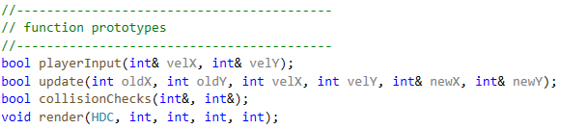
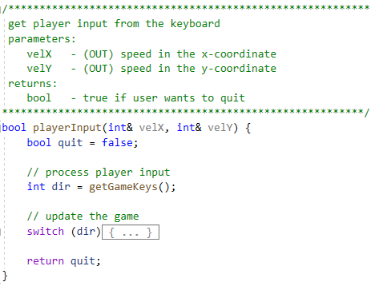
Player Input Function
Declare and Define a player input function between main and update
Returns true if player wants to quit
Parameters
Velocity (x, y) (by-reference)
Fix variable names in switch statement to parameter and return variable names

Slide 10
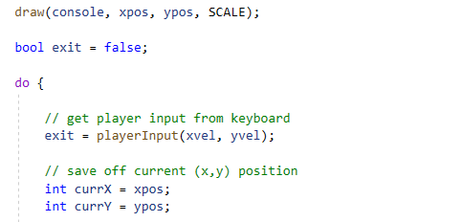

Call Player Input Function
Replace code at top of game loop to call player input function in main
Build and run the program…
…does X or Escape still quit the game?

Slide 11
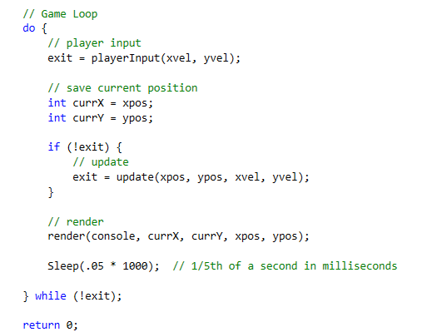
Fix Exit Condition
In the previous code
Return from update overwrites exit condition from player input
Modify code to add an IF statement around call to update
Do not call update if player input has set game end condition

